Slide 1
META-ANALYSIS ON THE ROLE
OF CHEMOTHERAPY IN NSCLC
IGR – MRC (BMJ 1995)
Absolute benefit with cisplatin containing regimens
S ± CT
S + RT ± CT
2 years
3%
2%
5 years
5%
2%

Slide 2
1995年，荟萃分析：含顺铂辅助治疗能获益
NSCLCCG 荟萃分析 (8项研究，1394例患者)
药物 (研究数/例数) | HR [95%CI] | P
烷化剂 (5/2145) | 1.15 [1.04-1.27] | 0.005
其他药物 (3/818) | 0.89 [0.72-1.11] | 0.30
含顺铂方案 (8/1394) | 0.87 [0.74-1.02] | 0.08
100
2年绝对获益：+3%
5年绝对获益：+5%
80
60
生存概率 (%)
HR=0.87
95%CI 0.74-1.02
P=0.08
40
手术+顺铂为基础的辅助化疗
20
单纯手术
0
0
12
24
36
48
60
时间 (月)
NSCLC collaborative group. BMJ 1995; 311:899-909.

Slide 3
NON-SMALL CELL LUNG CANCER
- 化疗药物 -
抗代谢类: | 铂类:
Gemcitabine | Cisplatin
 | Carboplatin
紫杉类: | Oxaliplatin
Docetaxel
Paclitaxel | 老药:
 | Etoposide
长春碱类: | Mitomycin
Vinorelbine | Vinblastine

Slide 4
NON-SMALL CELL LUNG CANCER
- 化疗 vs 支持治疗 (N = 778)* -
100
90
80
70
60
PERCENT SURVIVING:
50
40
30
20
10
0
0
2
4
6
8
10
12
14
16
18
20
22
24
MONTHS
SUPPORTIVE CARE
COMBINATION CHEMO
* Meta-Analysis: NSCLC Collaborative Group BMJ 311:899-909, 1995 p < 0.001

Slide 5
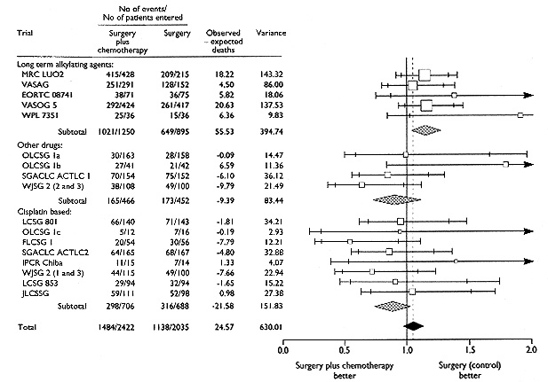
Adjuvant Chemotherapy in Early Stage NSCLC
Anonymous. Non-Small Cell Lung Cancer Collaborative Group. BMJ 311:899,1995

Slide 6
Main Results of Meta-analysis of Chemotherapy in Non-small Cell Lung Cancer
Drug used | Surgery
 | Harzard ratio(95% confidence interval) | P value | % Absolute Benefit (baseline)
 |  |  | At 2 years (70%) | At 5 years (50%)
Long term alkylating agents | 1.15 (1.04 to 1.27) | 0.005 | -4 | -5
Vinca alkaloid or etoposide | NA | NA | NA | NA
“Other”drugs | 0.89 (0.72 to 1.11) | 0.30 | 3 | 4
Cisplatin based drugs | 0.87 (0.74 to 1.02) | 0.08 | 3 | 5
Non-Small Cell Lung Cancer Collaborative Group. BMJ Vol311(7).1995

Slide 7
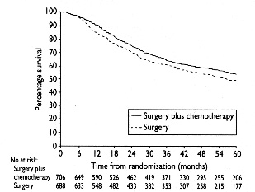
Meta-analysis: Survival with
Cisplatin-Based Adjuvant Chemotherapy
p=0.08
Non-Small Cell Lung Cancer Collaborative Group. BMJ Vol311(7).1995

